Slide 1


Leaf Classification & Optimizations using SGD Classifier
Presented to –
Dr. Liton Jude Rozario
Professor
Dept. of CSE
Presented by –
Shanjida Alam (ID: 353)
Jubaer Ahmad Khan (ID: 402)

Slide 2

outline
Introduction
Dataset Overview
Data Preprocessing and Preparation
Model Training
Model Evaluation
Performance Analysis
Strategies for Improvement
Conclusion and Future Work

Slide 3
DATASET OVERVIEW
The Leaf Dataset is collected from JU campus. It contains various species. But we have taken only 6 species for classification task. The dataset is given below -
Name of Species | No of Samples
Acer palmatum | 7
Ginkgo biloba | 13
Magnolia grandiflora | 13
Firmiana simplex | 15
Salix babylonica | 11
Cedrus deodara | 5
Total | 64
64 images are filtered from 638 files (for simplification)
RGB images are resized to 150x150 pixels
Data is augmented to increase the sample size and improve accuracy
Rest of the images are preserved for Testing

Slide 4
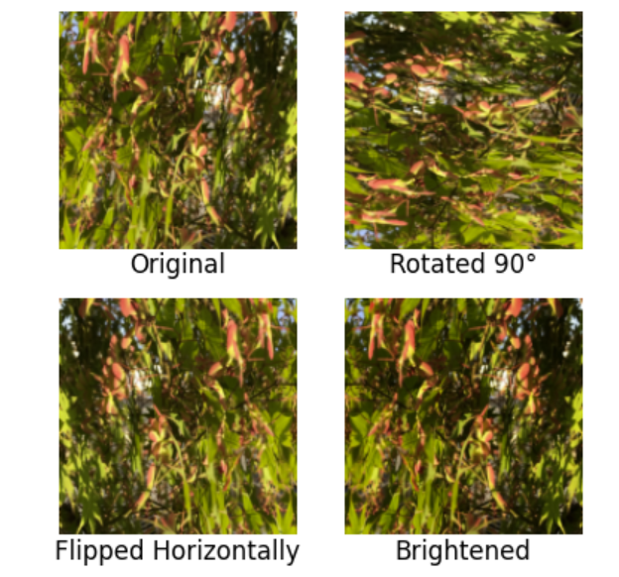
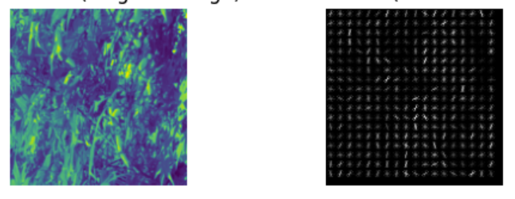
Data preprocessing and preparation
Load the Image Data
Resize the Image
Define Train Class and Filtering Label
Data Augmentation
HOG Transform
Encode Label
Further Training Process
Fig 1.1: Data Preprocessing Pipeline
Fig 1.2: Before HOG
(150x150 RGB Image)
Fig 1.3: After HOG Transform
HOG features i.e. Texture, Shapes
Fig 1.4: Data Augmentation Example

Slide 5
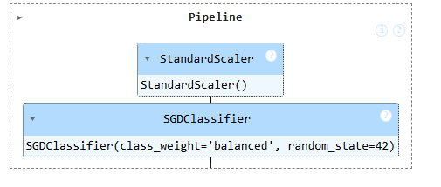
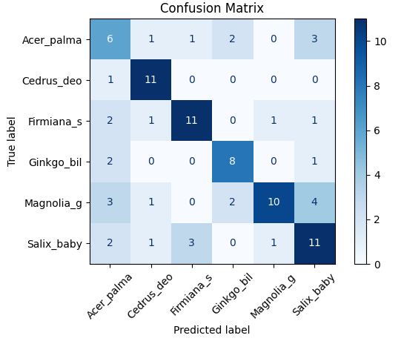
Model Training
The dataset is trained using SGD (Stochastic Gradient Descent) Classifier.
Before the training, the model hyperparameters were set to default
In Confusion Matrix, the diagonal refers to true labels and off-diagonal values means misclassifications (FP/FN)
It shows pretty good result as we perform it without any optimizations.
Fig 2.1: SGD Classifier Pipeline using default Hyperparameters
Fig 2.2: Multi-class Confusion Matrix for 20% validation data

Slide 6
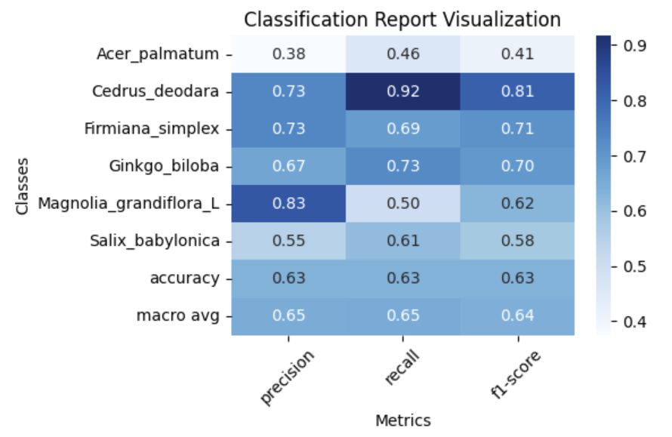
Model training (cont.)
The Reports shows the accuracy of 63%
Overall, a good performance as we have used small dataset as well as before optimization.
This classification report is generated using 20% remaining test set.
Fig 2.3: Classification Report using Heatmap before optimization.

Slide 7
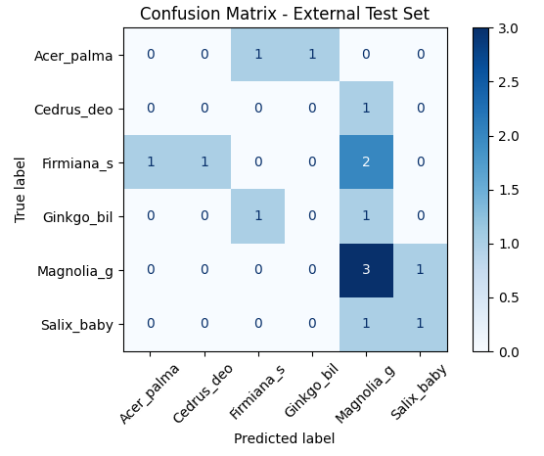
Performance analysis
Fig 3.1: Confusion matrix for unseen data

Slide 8
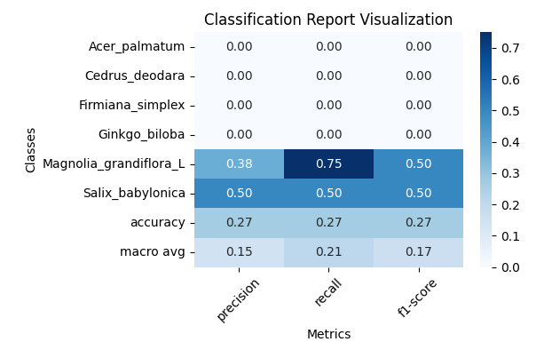
Performance analysis (CONT.)
Fig 3.2: Classification Report using Heatmap for Unseen Data

Slide 9
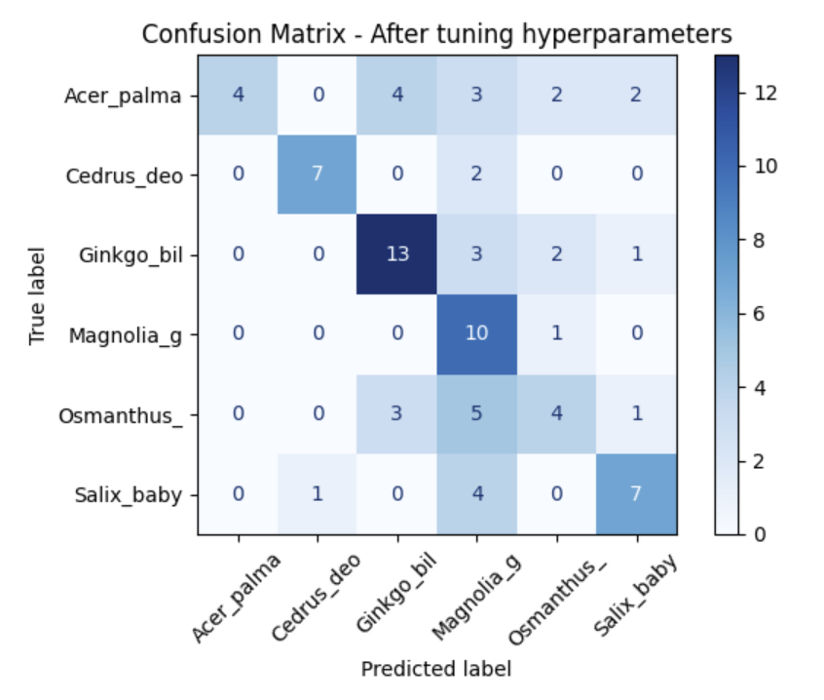
Strategies for improvement
For optimization, we used – GridSearchCV
GridSearchCV is something that finds best hyperparameters for the given dataset
For SGD Classifier, the hyperparameters are – loss, alpha, penalty, max_iter, tol
After the tuning, we got 56% accuracy. Which is improved a slight margin!
Fig 4.1: Confusion matrix after tuning hyperparameters (using GridSearchCV)

Slide 10
Future work
We can apply SMOTE (Synthetic Minority Oversampling Technique) in the training set to balanced train and test dataset. Which will significantly reduce overfitting and improve performance.
Instead of extracting features using HOG, some Convolution Neural Network (CNN) models such as VGG16 to extract features i.g shapes, textures, patterns.
Play with more models and see which performs better and make a comparison analysis.

